Slide 1
Cryptography
Notes:
Corporate Computer Security
Randall J. Boyle & Raymond R. Panko
Chapter 3

Slide 2




3.1: Cryptography
Cryptography is the use of mathematical operations to protect messages traveling between parties or stored on a computer
Confidentiality means that someone intercepting your communications cannot read them
???

Slide 3
3.1: Cryptography
Confidentiality is only one cryptographic protection
Authentication means proving one’s identity to another so they can trust you more
Integrity means that the message cannot be changed or, if it is change, that this change will be detected

Slide 4
3.1: Cryptography
Encryption for confidentiality needs a cipher (mathematical method) to encrypt and decrypt
The two parties using the cipher also need to know a secret key or keys
The key or keys must be kept secret
Cryptanalysts attempt to crack (find) the key

Slide 5
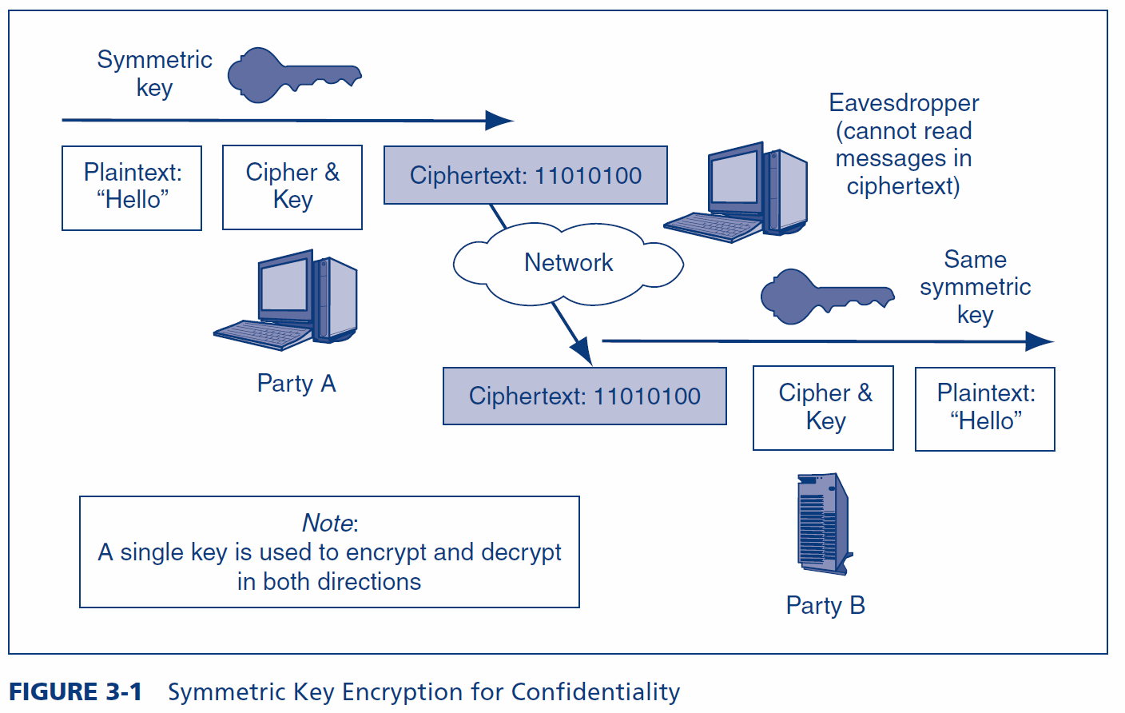
3.1: Symmetric Key Encryption for Confidentiality

Slide 6
3.1: Ciphers versus Codes
Ciphers can encrypt any message expressed in binary (1s and 0s)
This flexibility and the speed of computing makes ciphers dominant for encryption today
Codes are more specialized
They substitute one thing for another
Usually a word for another word or a number for a word
Codes are good for humans and may be included in messages sent via encipherment

Slide 7
3.2: Major Symmetric Key Encryption Ciphers
 | RC4 | DES | 3DES | AES
Key Length (bits) | 40 bits or more | 56 | 112 or 168 | 128, 192, or 256
Key Strength | Very weak at 40 bits | Weak | Strong | Strong
Processing Requirements | Low | Moderate | High | Low
RAM Requirements | Low | Moderate | Moderate | Low
Remarks | Can use keys of variable length | Created in the 1970s | Applies DES three times with two or three different DES keys | Today’s gold standard for symmetric key encryption

Slide 8
3.5: Hashing
Hashing
A hashing algorithm is applied to a bit string of any length
The result of the calculation is called the hash
For a given hashing algorithm, all hashes are the same short length
Hashing
Algorithm
Bit string of any length
Hash: bit string of small fixed length

Slide 9
3.5: Hashing
Hashing versus Encryption
Characteristic | Encryption | Hashing
Result length | About the same length as the plaintext | Short fixed length regardless of message length
Reversible? | Yes. Decryption | No. There is no way to get from the short hash back to the long original message

Slide 10
3.5: Hashing
Hashing Algorithms
MD5 (128-bit hashes)
SHA-1 (160-bit hashes)
SHA-224, SHA-256, SHA-384, and SHA-512 (name gives hash length in bits)
Note: MD5 and SHA-1 should not be used because they have been shown to be unsecure

Slide 11
Cryptography and Network Security Chapter 2 Classical Encryption Techniques
Notes:
Lecture slides by Lawrie Brown for “Cryptography and Network Security”, 4/e, by William Stallings, Chapter 2 – “Classical Encryption Techniques”.

Slide 12
Symmetric Encryption
or conventional / private-key / single-key
sender and recipient share a common key
all classical encryption algorithms are private-key
was only type prior to invention of public-key in 1970’s
and by far most widely used
Notes:
Symmetric encryption, also referred to as conventional encryption or single-key encryption, was the only type of encryption in use prior to the development of public-key encryption in the 1970s. It remains by far the most widely used of the two types of encryption. All traditional schemes are symmetric / single key / private-key encryption algorithms, with a single key, used for both encryption and decryption. Since both sender and receiver are equivalent, either can encrypt or decrypt messages using that common key.

Slide 13
Some Basic Terminology
plaintext - original message
ciphertext - coded message
cipher - algorithm for transforming plaintext to ciphertext
key - info used in cipher known only to sender/receiver
encipher (encrypt) - converting plaintext to ciphertext
decipher (decrypt) - recovering ciphertext from plaintext
cryptography - study of encryption principles/methods
cryptanalysis (codebreaking) - study of principles/ methods of deciphering ciphertext without knowing key
cryptology - field of both cryptography and cryptanalysis
Notes:
Briefly review some terminology used throughout the course.

Slide 14
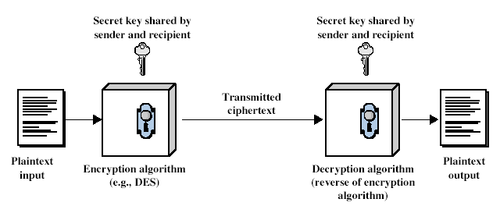
Symmetric Cipher Model
Notes:
Detail the five ingredients of the symmetric cipher model, shown in Stallings Figure 2.1:
plaintext - original message
encryption algorithm – performs substitutions/transformations on plaintext
secret key – control exact substitutions/transformations used in encryption algorithm
ciphertext - scrambled message
decryption algorithm – inverse of encryption algorithm

Slide 15
Requirements
two requirements for secure use of symmetric encryption:
a strong encryption algorithm
a secret key known only to sender / receiver
mathematically have:
Y = E_{K}(X)
X = D_{K}(Y)
assume encryption algorithm is known
implies a secure channel to distribute key
Notes:
We assume that it is impractical to decrypt a message on the basis of the cipher- text plus knowledge of the encryption/decryption algorithm, and do not need to keep the algorithm secret; rather we only need to keep the key secret. This feature of symmetric encryption is what makes it feasible for widespread use. It allows easy distribution of s/w and h/w implementations.
Can take a closer look at the essential elements of a symmetric encryption scheme: mathematically it can be considered a pair of functions with: plaintext X, ciphertext Y, key K, encryption algorithm E_{K}, decryption algorithm D_{K}.

Slide 16
Cryptography
characterize cryptographic system by:
type of encryption operations used
substitution / transposition / product
number of keys used
single-key or private / two-key or public
way in which plaintext is processed
block / stream
Notes:
Cryptographic systems can be characterized along these three independent dimensions.

Slide 17
Cryptanalysis
objective to recover key not just message
general approaches:
cryptanalytic attack
brute-force attack
Notes:
Typically objective is to recover the key in use rather then simply to recover the plaintext of a single ciphertext.
There are two general approaches:
Cryptanalytic attacks rely on the nature of the algorithm plus perhaps some knowledge of the general characteristics of the plaintext or even some sample plaintext-ciphertext pairs.
Brute-force attacks try every possible key on a piece of ciphertext until an intelligible translation into plaintext is obtained. On average,half of all possible keys must be tried to achieve success.

Slide 18
Cryptanalytic Attacks
ciphertext only
only know algorithm & ciphertext, is statistical, know or can identify plaintext
known plaintext
know/suspect plaintext & ciphertext
chosen plaintext
select plaintext and obtain ciphertext
chosen ciphertext
select ciphertext and obtain plaintext
chosen text
select plaintext or ciphertext to en/decrypt
Notes:
Stallings Table 2.1 summarizes the various types of cryptanalytic attacks, based on the amount of information known to the cryptanalyst, from least to most. The most difficult problem is presented when all that is available is the ciphertext only. In some cases, not even the encryption algorithm is known, but in general we can assume that the opponent does know the algorithm used for encryption. Then with increasing information have the other attacks. Generally, an encryption algorithm is designed to withstand a known-plaintext attack.

Slide 19
Brute Force Search
always possible to simply try every key
most basic attack, proportional to key size
assume either know / recognise plaintext
Key Size (bits) | Number of Alternative Keys | Time required at 1 decryption/µs | Time required at 10⁶ decryptions/µs
32 | 2³² = 4.3 × 10⁹ | 2³¹ µs = 35.8 minutes | 2.15 milliseconds
56 | 2⁵⁶ = 7.2 × 10¹⁶ | 2⁵⁵ µs = 1142 years | 10.01 hours
128 | 2¹²⁸ = 3.4 × 10³⁸ | 2¹²⁷ µs = 5.4 × 10²⁴ years | 5.4 × 10¹⁸ years
168 | 2¹⁶⁸ = 3.7 × 10⁵⁰ | 2¹⁶⁷ µs = 5.9 × 10³⁶ years | 5.9 × 10³⁰ years
26 characters (permutation) | 26! = 4 × 10²⁶ | 2 × 10²⁶ µs = 6.4 × 10¹² years | 6.4 × 10⁶ years
Notes:
A brute-force attack involves trying every possible key until an intelligible translation of the ciphertext into plaintext is obtained. On average, half of all possible keys must be tried to achieve success. Stallings Table 2.2 shows how much time is required to conduct a brute-force attack, for various common key sizes (DES is 56, AES is 128, Triple-DES is 168, plus general mono-alphabetic cipher), where either a single system or a million parallel systems, are used.

Slide 20
Classical Substitution Ciphers
where letters of plaintext are replaced by other letters or by numbers or symbols
or if plaintext is viewed as a sequence of bits, then substitution involves replacing plaintext bit patterns with ciphertext bit patterns
Notes:
In this section and the next, we examine a sampling of what might be called classical encryption techniques. A study of these techniques enables us to illustrate the basic approaches to symmetric encryption used today and the types of cryptanalytic attacks that must be anticipated. The two basic building blocks of all encryption technique are substitution and transposition. We examine these in the next two sections. Finally, we discuss a system that combine both substitution and transposition.

Slide 21
Caesar Cipher
earliest known substitution cipher
by Julius Caesar
first attested use in military affairs
replaces each letter by 3rd letter on
example:
MEET ME AFTER THE TOGA PARTY
PHHW PH DIWHU WKH WRJD SDUWB
https://www.khanacademy.org/computing/computer-science/cryptography/crypt/v/caesar-cipher
https://cryptii.com/pipes/caesar-cipher
Notes:
Substitution ciphers form the first of the fundamental building blocks. The core idea is to replace one basic unit (letter/byte) with another. Whilst the early Greeks described several substitution ciphers, the first attested use in military affairs of one was by Julius Caesar, described by him in Gallic Wars (cf. Kahn pp83-84). Still call any cipher using a simple letter shift a caesar cipher, not just those with shift 3.

Slide 22
Caesar Cipher
can define transformation as:
a b c d e f g h i j k l m n o p q r s t u v w x y z
D E F G H I J K L M N O P Q R S T U V W X Y Z A B C
mathematically give each letter a number
a b c d e f g h i j k l m n o p q r s t u v w x y z
0 1 2 3 4 5 6 7 8 9 10 11 12 13 14 15 16 17 18 19 20 21 22 23 24 25
then have Caesar cipher as:
c = E(p) = (p + k) mod (26)
p = D(c) = (c – k) mod (26)
Notes:
This mathematical description uses modulo (clock) arithmetic. Here, when you reach Z you go back to A and start again. Mod 26 implies that when you reach 26, you use 0 instead (ie the letter after Z, or 25 + 1 goes to A or 0).
Example: howdy (7,14,22,3,24) encrypted using key f (ie a shift of 5) is MTBID

Slide 23
Cryptanalysis of Caesar Cipher
only have 26 possible ciphers
A maps to A,B,..Z
could simply try each in turn
a brute force search
given ciphertext, just try all shifts of letters
do need to recognize when have plaintext
eg. break ciphertext "GCUA VQ DTGCM"
Notes:
With a caesar cipher, there are only 26 possible keys, of which only 25 are of any use, since mapping A to A etc doesn't really obscure the message! Note this basic rule of cryptanalysis "check to ensure the cipher operator hasn't goofed and sent a plaintext message by mistake"!
Can try each of the keys (shifts) in turn, until can recognise the original message. See Stallings Fig 2.3 for example of search.
Note: as mentioned before, do need to be able to recognise when have an original message (ie is it English or whatever). Usually easy for humans, hard for computers. Though if using say compressed data could be much harder.
Example "GCUA VQ DTGCM" when broken gives "easy to break", with a shift of 2 (key C).

Slide 24
Monoalphabetic Cipher
rather than just shifting the alphabet
could shuffle (jumble) the letters arbitrarily
each plaintext letter maps to a different random ciphertext letter
hence key is 26 letters long
Plain: abcdefghijklmnopqrstuvwxyz
Cipher: DKVQFIBJWPESCXHTMYAUOLRGZN
Plaintext: ifwewishtoreplaceletters
Ciphertext: WIRFRWAJUHYFTSDVFSFUUFYA
Notes:
With only 25 possible keys, the Caesar cipher is far from secure. A dramatic increase in the key space can be achieved by allowing an arbitrary substitution, where the translation alphabet can be any permutation of the 26 alphabetic characters.
See example translation alphabet, and an encrypted message using it.

Slide 25
Monoalphabetic Cipher Security
now have a total of 26! = 4 x 1026 keys
with so many keys, might think is secure
but would be !!!WRONG!!!
problem is language characteristics
Notes:
Note that even given the very large number of keys, being 10 orders of magnitude greater than the key space for DES, the monoalphabetic substitution cipher is not secure, because it does not sufficiently obscure the underlying language characteristics.

Slide 26
Language Redundancy and Cryptanalysis
human languages are redundant
eg "th lrd s m shphrd shll nt wnt"
letters are not equally commonly used
in English E is by far the most common letter
followed by T,R,N,I,O,A,S
other letters like Z,J,K,Q,X are fairly rare
have tables of single, double & triple letter frequencies for various languages
Notes:
As the example shows, we don't actually need all the letters in order to understand written English text. Here vowels were removed, but they're not the only redundancy. cf written Hebrew has no vowels for same reason. Are usually familiar with "party conversations", can hear one person speaking out of hubbub of many, again because of redundancy in aural language also. This redundancy is also the reason we can compress text files, the computer can derive a more compact encoding without losing any information. Basic idea is to count the relative frequencies of letters, and note the resulting pattern.

Slide 27
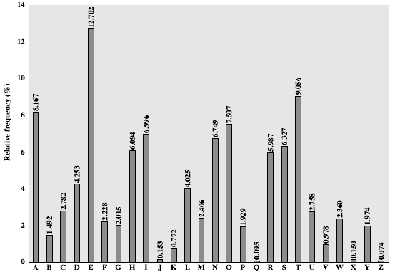
English Letter Frequencies
Notes:
Note that all human languages have varying letter frequencies, though the number of letters and their frequencies varies. Stallings Figure 2.5 shows English letter frequencies. Seberry & Pieprzyk, "Cryptography - An Introduction to Computer Security", Prentice-Hall 1989, Appendix A has letter frequency graphs for 20 languages (most European & Japanese & Malay).

Slide 28
Use in Cryptanalysis
key concept - monoalphabetic substitution ciphers do not change relative letter frequencies
discovered by Arabian scientists in 9th century
calculate letter frequencies for ciphertext
compare counts/plots against known values
if caesar cipher look for common peaks/troughs
peaks at: A-E-I triple, NO pair, RST triple
troughs at: JK, X-Z
for monoalphabetic must identify each letter
tables of common double/triple letters help
Notes:
The simplicity and strength of the monoalphabetic substitution cipher meant it dominated cryptographic use for the first millenium AD. It was broken by Arabic scientists. The earliest known description is in Abu al-Kindi's "A Manuscript on Deciphering Cryptographic Messages", published in the 9th century but only rediscovered in 1987 in Istanbul, but other later works also attest to their knowledge of the field. Monoalphabetic ciphers are easy to break because they reflect the frequency data of the original alphabet. The cryptanalyst looks for a mapping between the observed pattern in the ciphertext, and the known source language letter frequencies. If English, look for peaks at: A-E-I triple, NO pair, RST triple, and troughs at: JK, X-Z.

Slide 29
Example Cryptanalysis
given ciphertext:
UZQSOVUOHXMOPVGPOZPEVSGZWSZOPFPESXUDBMETSXAIZ
VUEPHZHMDZSHZOWSFPAPPDTSVPQUZWYMXUZUHSX
EPYEPOPDZSZUFPOMBZWPFUPZHMDJUDTMOHMQ
count relative letter frequencies (see text)
guess P & Z are e and t
guess ZW is th and hence ZWP is the
proceeding with trial and error finally get:
it was disclosed yesterday that several informal but
direct contacts have been made with political
representatives of the viet cong in moscow
Notes:
Illustrate the process with this example from the text in Stallings section 2.2.

Slide 30
Polyalphabetic Ciphers
polyalphabetic substitution ciphers
improve security using multiple cipher alphabets
make cryptanalysis harder with more alphabets to guess and flatter frequency distribution
use a key to select which alphabet is used for each letter of the message
use each alphabet in turn
repeat from start after end of key is reached
https://www.khanacademy.org/computing/computer-science/cryptography/crypt/v/polyalphabetic-cipher
Notes:
One approach to reducing the "spikyness" of natural language text is used the Playfair cipher which encrypts more than one letter at once. We now consider the other alternative, using multiple cipher alphabets in turn. This gives the attacker more work, since many alphabets need to be guessed, and because the frequency distribution is more complex, since the same plaintext letter could be replaced by several ciphertext letters, depending on which alphabet is used. The general name for this approach is a polyalphabetic substitution cipher. All these techniques have the following features in common:
A set of related monoalphabetic substitution rules is used.
2. A key determines which particular rule is chosen for a given transformation.

Slide 31
Vigenère Cipher
simplest polyalphabetic substitution cipher
effectively multiple caesar ciphers
key is multiple letters long K = k₁ k₂ ... k_{d}
i^{th} letter specifies i^{th} alphabet to use
use each alphabet in turn
repeat from start after d letters in message
decryption simply works in reverse
Notes:
The best known, and one of the simplest, such algorithms is referred to as the Vigenère cipher, where the set of related monoalphabetic substitution rules consists of the 26 Caesar ciphers, with shifts of 0 through 25. Each cipher is denoted by a key letter, which is the ciphertext letter that substitutes for the plaintext letter ‘a’, and which are each used in turn, as shown next.

Slide 32
Example of Vigenère Cipher
write the plaintext out
write the keyword repeated above it
use each key letter as a caesar cipher key
encrypt the corresponding plaintext letter
eg using keyword deceptive
key: deceptivedeceptivedeceptive
plaintext: wearediscoveredsaveyourself
ciphertext:ZICVTWQNGRZGVTWAVZHCQYGLMGJ
Notes:
Discuss this simple example from text Stallings section 2.2.

Slide 33
Security of Vigenère Ciphers
have multiple ciphertext letters for each plaintext letter
hence letter frequencies are obscured
but not totally lost
start with letter frequencies
see if look monoalphabetic or not
if not, then need to determine number of alphabets, since then can attach each
Notes:
The Vigenère & related polyalphabetic ciphers still do not completely obscure the underlying language characteristics.
The key to breaking them was to identify the number of translation alphabets, and then attack each separately.

Slide 34
Autokey Cipher
ideally want a key as long as the message
Vigenère proposed the autokey cipher
with keyword is prefixed to message as key
knowing keyword can recover the first few letters
use these in turn on the rest of the message
but still have frequency characteristics to attack
eg. given key deceptive
key: deceptivewearediscoveredsav
plaintext: wearediscoveredsaveyourself
ciphertext:ZICVTWQNGKZEIIGASXSTSLVVWLA
Notes:
Taking the polyalphabetic idea to the extreme, want as many different translation alphabets as letters in the message being sent. One way of doing this with a smallish key, is to use the Autokey cipher.
The example uses the keyword "DECEPTIVE" prefixed to as much of the message "WEAREDISCOVEREDSAV" as is needed. When deciphering, recover the first 9 letters using the keyword "DECEPTIVE". Then instead of repeating the keyword, start using the recovered letters from the message "WEAREDISC". As recover more letters, have more of key to recover later letters.
Problem is that the same language characteristics are used by the key as the message. ie. a key of 'E' will be used more often than a 'T' etc hence an 'E' encrypted with a key of 'E' occurs with probability (0.1275)2 = 0.01663, about twice as often as a 'T' encrypted with a key of 'T' have to use a larger frequency table, but it exists given sufficient ciphertext this can be broken.

Slide 35
One-Time Pad
if a truly random key as long as the message is used, the cipher will be secure
called a One-Time pad
is unbreakable since ciphertext bears no statistical relationship to the plaintext
since for any plaintext & any ciphertext there exists a key mapping one to other
can only use the key once though
problems in generation & safe distribution of key
Notes:
The One-Time Pad is an evolution of the Vernham cipher, which was invented by Gilbert Vernham in 1918, and used a long tape of random letters to encrypt the message. An Army Signal Corp officer, Joseph Mauborgne, proposed an improvement using a random key that was truly as long as the message, with no repetitions, which thus totally obscures the original message. It produces random output that bears no statistical relationship to the plaintext. Because the ciphertext contains no information whatsoever about the plaintext, there is simply no way to break the code, since any plaintext can be mapped to any ciphertext given some key.
The one-time pad offers complete security but, in practice, has two fundamental difficulties:
There is the practical problem of making large quantities of random keys.
2. And the problem of key distribution and protection, where for every message to be sent, a key of equal length is needed by both sender and receiver.
Because of these difficulties, the one-time pad is of limited utility, and is useful primarily for low-bandwidth channels requiring very high security.

Slide 36
Transposition Ciphers
now consider classical transposition or permutation ciphers
these hide the message by rearranging the letter order
without altering the actual letters used
can recognise these since have the same frequency distribution as the original text
Notes:
All the techniques examined so far involve the substitution of a ciphertext symbol for a plaintext symbol. A very different kind of mapping is achieved by performing some sort of permutation on the plaintext letters. This technique is referred to as a transposition cipher, and form the second basic building block of ciphers. The core idea is to rearrange the order of basic units (letters/bytes/bits) without altering their actual values.

Slide 37
Rail Fence cipher
write message letters out diagonally over a number of rows
then read off cipher row by row
eg. write message out as:
m e m a t r h t g p r y
e t e f e t e o a a t
giving ciphertext
MEMATRHTGPRYETEFETEOAAT
Notes:
The simplest such cipher is the rail fence technique, in which the plaintext is written down as a sequence of diagonals and then read off as a sequence of rows.
The example message is: "meet me after the toga party" with a rail fence of depth 2.
This sort of thing would be trivial to cryptanalyze.

Slide 38
Row Transposition Ciphers
a more complex transposition
write letters of message out in rows over a specified number of columns
then reorder the columns according to some key before reading off the rows
Key: 3 4 2 1 5 6 7
Plaintext: a t t a c k p
o s t p o n e
d u n t i l t
w o a m x y z
Ciphertext: TTNAAPTMTSUOAODWCOIXKNLYPETZ
Notes:
A more complex transposition cipher is to write the message in a rectangle, row by row, and read the message off shuffling the order of the columns in each row.
A pure transposition cipher is easily recognized because it has the same letter frequencies as the original plaintext. For the type of columnar transposition just shown, cryptanalysis is fairly straightforward and involves laying out the ciphertext in a matrix and playing around with column positions. Digram and trigram frequency tables can be useful.

Slide 39
Product Ciphers
ciphers using substitutions or transpositions are not secure because of language characteristics
hence consider using several ciphers in succession to make harder, but:
two substitutions make a more complex substitution
two transpositions make more complex transposition
but a substitution followed by a transposition makes a new much harder cipher
this is bridge from classical to modern ciphers
Notes:
Have seen that ciphers based on just substitutions or transpositions are not secure, and can be attacked because they do not sufficient obscure the underlying language structure
So consider using several ciphers in succession to make harder.
A substitution followed by a transposition is known as a Product Cipher, and makes a new much more secure cipher, and forms the bridge to modern ciphers.

Slide 40
Rotor Machines
before modern ciphers, rotor machines were most common complex ciphers in use
widely used in WW2
German Enigma, Allied Hagelin, Japanese Purple
implemented a very complex, varying substitution cipher
used a series of cylinders, each giving one substitution, which rotated and changed after each letter was encrypted
with 3 cylinders have 26³=17576 alphabets
Notes:
The next major advance in ciphers required use of mechanical cipher machines which enabled to use of complex varying substitutions.
A rotor machine consists of a set of independently rotating cylinders through which electrical pulses can flow. Each cylinder has 26 input pins and 26 output pins, with internal wiring that connects each input pin to a unique output pin. If we associate each input and output pin with a letter of the alphabet, then a single cylinder defines a monoalphabetic substitution. After each input key is depressed, the cylinder rotates one position, so that the internal connections are shifted accordingly. The power of the rotor machine is in the use of multiple cylinders, in which the output pins of one cylinder are connected to the input pins of the next, and with the cylinders rotating like an “odometer”, leading to a very large number of substitution alphabets being used, eg with 3 cylinders have 26³=17576 alphabets used.
They were extensively used in world war 2, and the history of their use and analysis is one of the great stories from WW2.

Slide 41

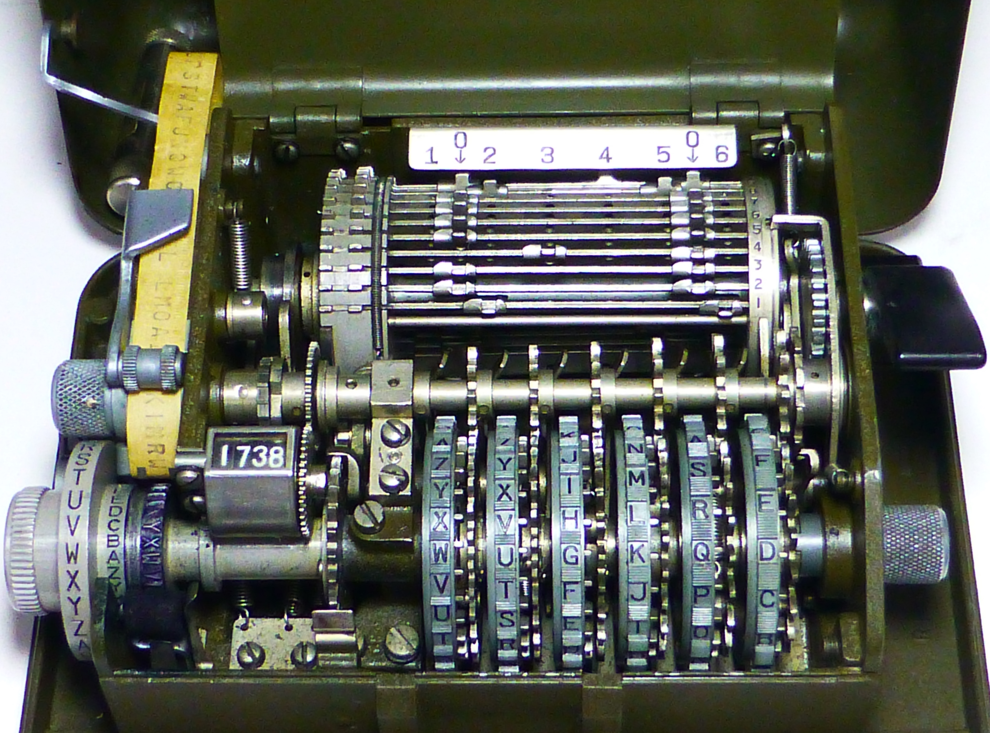
Hagelin Rotor Machine
Enigma machine
Notes:
This photo of an Allied Hagelin machine was taken by Lawrie Brown at Eurocrypt'93 in Norway. Note pen for scale, and the rotating cipher wheels near the front.

Slide 42
Steganography
an alternative to encryption
hides existence of message
using only a subset of letters/words in a longer message marked in some way
using invisible ink
hiding in LSB in graphic image or sound file
has drawbacks
high overhead to hide relatively few info bits
Notes:
Steganography is an alternative to encryption which hides the very existence of a message by some means. There are a large range of techniques for doing this.
Steganography has a number of drawbacks when compared to encryption. It requires a lot of overhead to hide a relatively few bits of information.
Also, once the system is discovered, it becomes virtually worthless, although a message can be first encrypted and then hidden using steganography.

Slide 43
Summary
have considered:
classical cipher techniques and terminology
monoalphabetic substitution ciphers
cryptanalysis using letter frequencies
polyalphabetic ciphers
transposition ciphers
product ciphers
rotor machines
Notes:
Chapter 2 summary.

